Slide 1
Generative Adversarial Networks
Brett Powers
Jan 6, 2021

Slide 2
GANs
Proposed in a 2014 paper (Goodfellow et al.)
Very powerful and has surprisingly intuitive aspects.
In a 2016 paper (Radford et al.) the idea of Deep Convolutional GANs (DCGANs) is introduced
Goes from fully connected networks to CNN which are great for spatial correlations.
Basic Idea as an Analogy:
Art Forger
Art Expert
VS

Slide 3
Analogy
Forger wants to replicate art and make money.
Tries their first painting which looks like this:
(They only got one quick look at it…)
Expert instantly sees it is a fake and tosses it out.
Forger doesn’t make money and now tries to learn what they did wrong.

Slide 4
Analogy
New painting from forger after corrections.
Expert takes a long look
Is still “pretty certain” this is a fake and tosses it out.
This process goes in a cycle
Theoretical convergence happens when the ”expert” is only guessing if the painting is fake or real.

Slide 5
What are GANs
GANs are the novel concept of pinning two networks against each other.
Generator network : Similar to the decoder in VAE. Takes in random noise and outputs “fake” data which are typically images.
Discriminator: Samples from a pool of “real” and “fake” images and classifies as either real or fake.
Zero-sum game. Networks have opposite goals.
Forger == Generator & Expert == Discriminator

Slide 6
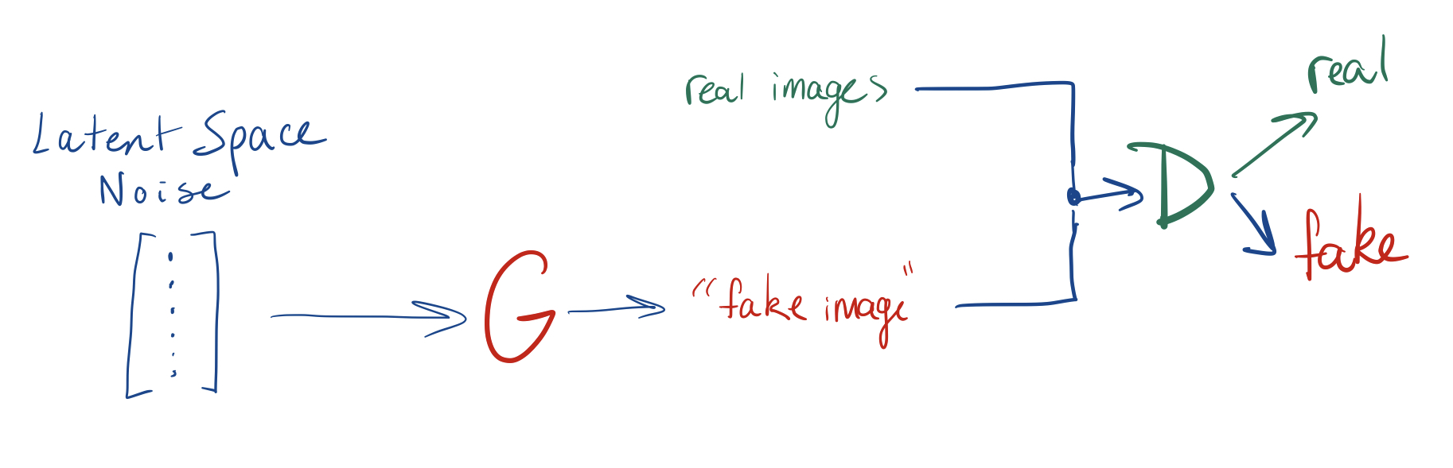
Basic Diagram of the Flow

Slide 7
Latent Space
Similar to VAE we have this notion of a latent space when sampling from a distribution.
Cool idea is that small changes within this initial latent space sampling can lead to small changes with the output of the generator.
Also, certain vectors within the latent space can relate back to “real world” understanding.

Slide 8
Latent Space Example
Fake cat generator.
There could be vectors within the latent space dealing with:
Cats size
Color of fur
Eye shape
Facial Expression
Tail length etc...
These vectors can be manipulated using simple vector algebra!

Slide 9
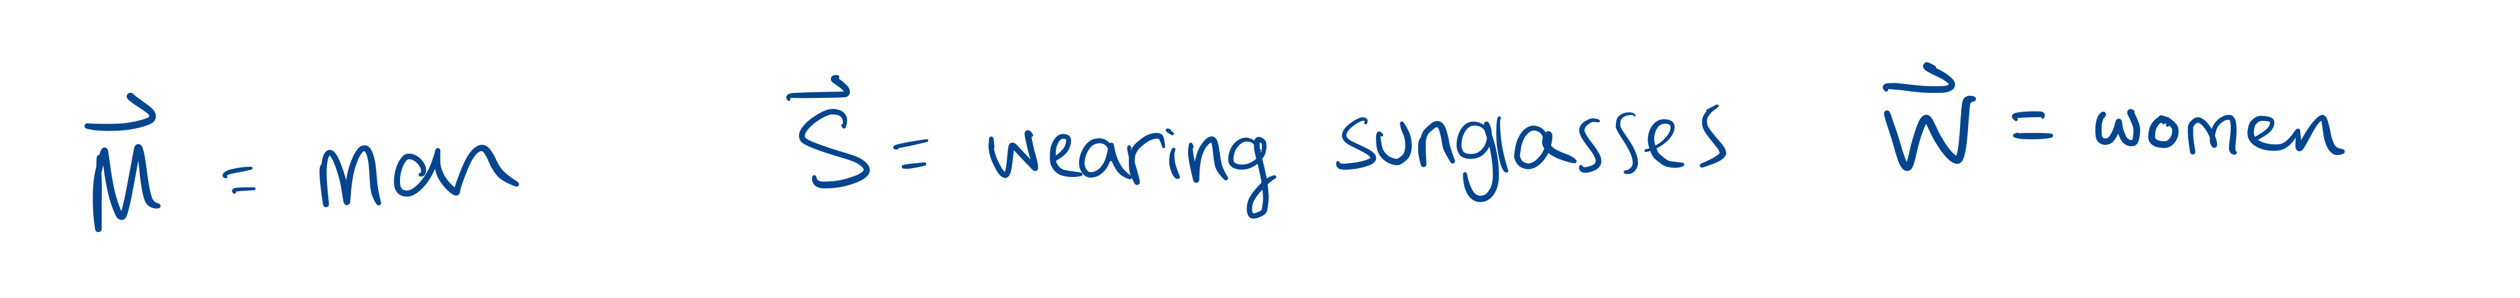
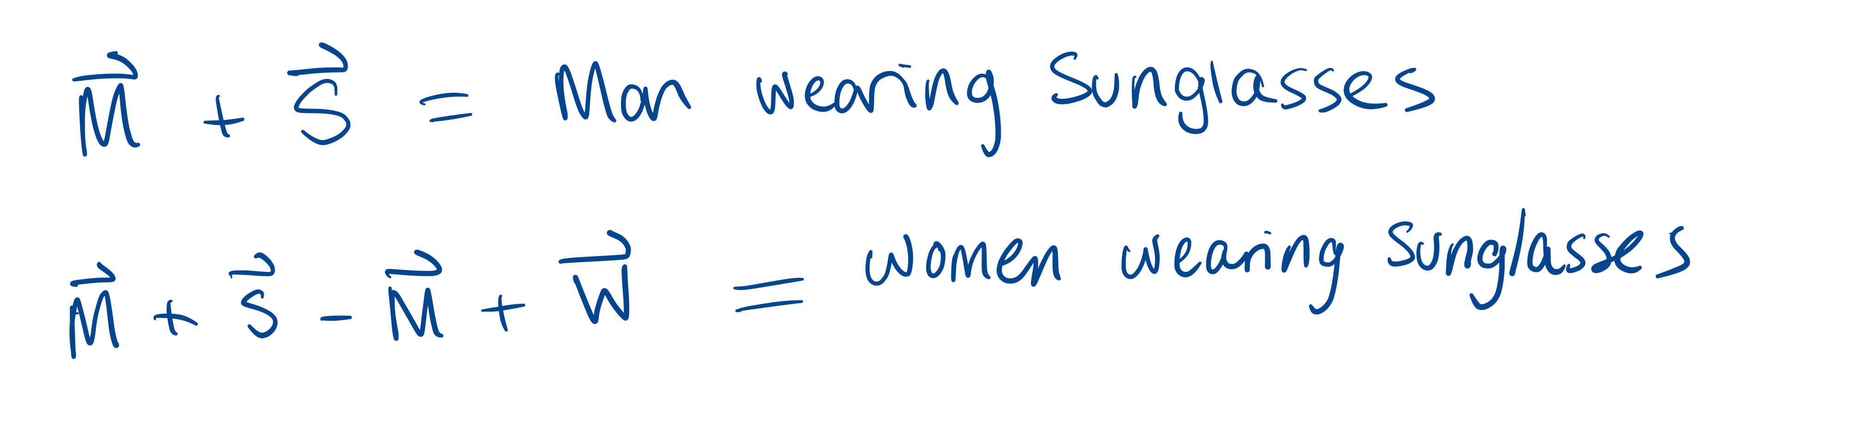

Slide 10
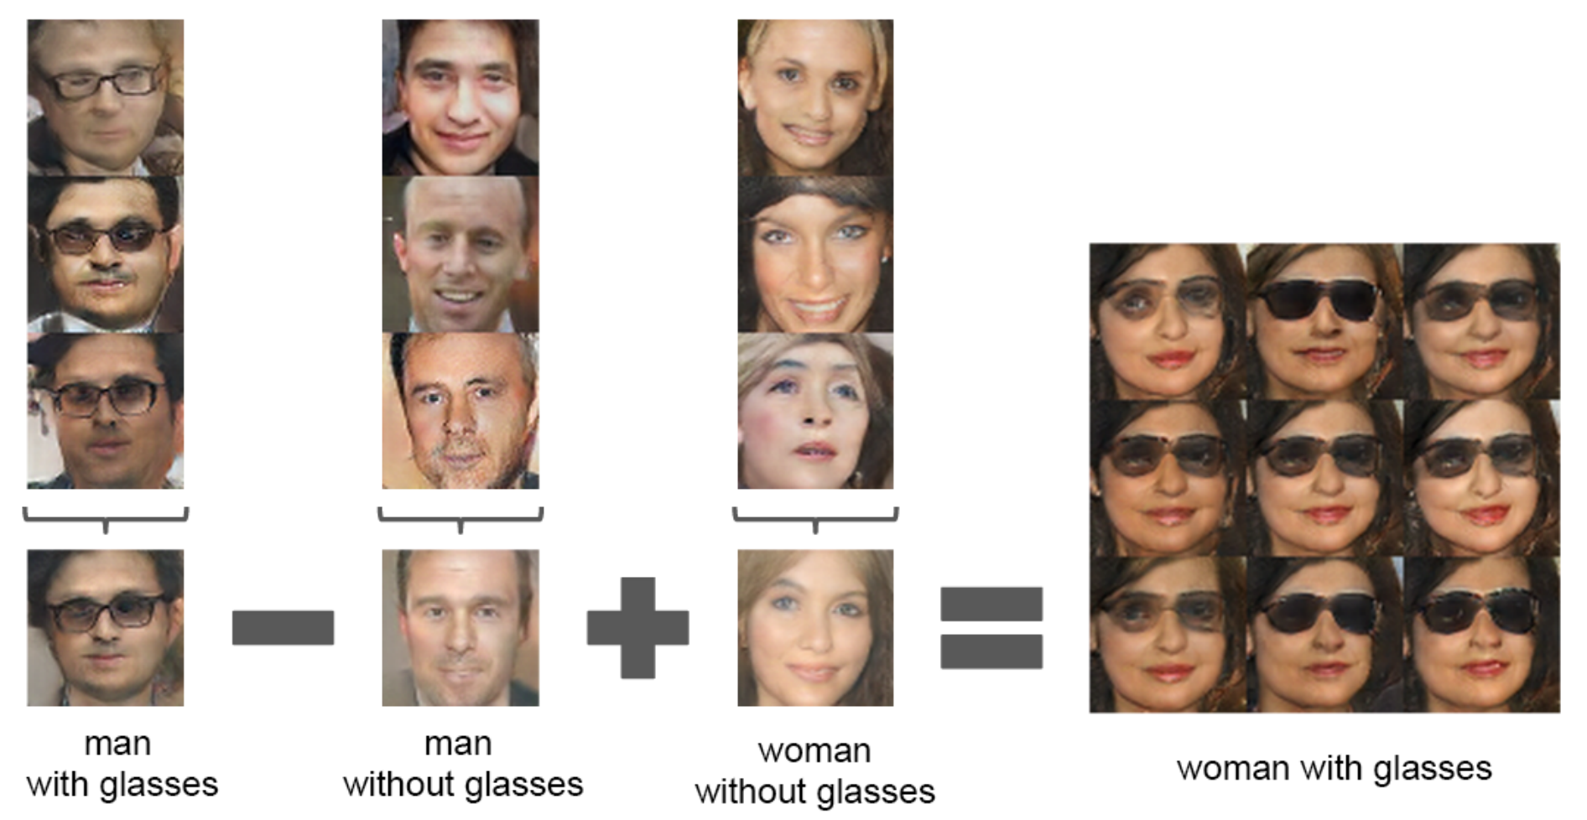

Slide 11
Goodfellow has been on record stating this could be a dangerous use case.
Use to alter photos realistically
Could be useful in aging photos of missing people.
These are not perfect either there are lots of issues with stability.

Slide 12
Difficulties of Training GANs
Could end up in “Nash Equilibrium” (John Nash mathematician/ game theorist). Neither side should change strategy.
Predator chases prey. Prey runs away. Both should keep their strategies.
Nash Equilibrium for a GAN is the generator (G) creating very good images and the discriminator (D) guessing 50/50. However, you cannot guarantee you will reach this equilibrium.
Mode Collapse: Take the MNIST dataset (fashion). If G gets very good at making Pants images. It will focus on trying to make only Pants to fool the D. This could lead to cycling between classes.

Slide 13
DCGANs Main Guidelines
Use strided convolutions not pooling and transpose convolutions in G
Batch Normalization in both G and D except in G(out) and D(in)
Remove fully connected hidden layers
Use ReLU in G for all layers except output should be tanh.
Use leaky ReLU activation in all layers in D.
Will work for most cases, but not all.
Very good for learning latent representations.
With very large images you get good local features but less good global coherence.

Slide 14
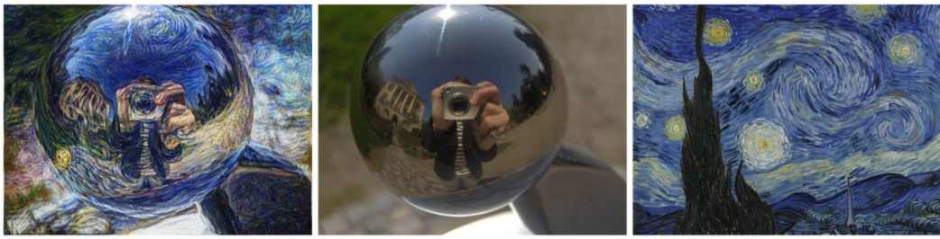
StyleGANs
Created by Nvidia team in 2018
Used style transfer techniques in G to ensure local structure is same as training images.
Keras has pretrained models ready to play with!

Slide 15
Drug Discovery
Insilico used main idea of GANs to ”create” novel drugs that had reason to treat diseases.
Use a simple image based representation of a molecule.
How many oxygens, hydrogens…
Cyclic or not etc…
Less guess work, more targeted approach.

Slide 16
Our Work?
Discussion

